Slide 1
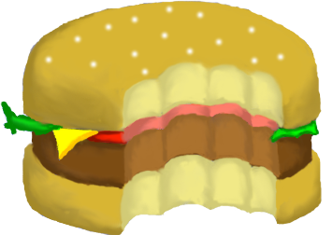
Team Social Foodies
Jason Villemarette
James Gray
Durel Hoover
Sam Seghers

Slide 2
About YouChew
Searching for places to eat
Social connections

Slide 3







Technologies

Slide 4
Completed Tasks
Facebook login and comments
Mapbox (w/ HTML5 Geolocation)
Foursquare API
HTML/CSS styling
Food Roulette Wheel

Slide 5
Future Work
Hotspots and discounts
More social networks
Restaurant coupons

Slide 6
Prepare thyself
Demo cometh
www.youchewfood.com

